Slide 1

EVENT MANAGEMENT WEBSITE
Prepared by: Under the supervision of:
1CR21IS077 Mrs. Shilpa Mangesh, Asst Prof
1CR21IS138 Mrs. Vijayasanthi, Asst prof
1CR21IS143
Department of Information Science and Engineering
CMR Institute of Technology
AECS Layout, Bengaluru, Karnataka, India

Slide 2
OBJECTIVES
To create a website for an event management company ‘MAJESTIC MILESTONES’ using django
To allow easy bookings of events from the events available
To allow customer to browse and make bookings
For we the creaters of the website to get an better understanding of django and the various other tools used
Department of Information Science and Engineering
CMR Institute of Technology
AECS Layout, Bengaluru, Karnataka, India
1

Slide 3
TOOLS AND TECHNIQUES USED
Software required
Django Framework
HTML, CSS and JavaScript
MySQL
Bootstrap
Django Adin
Python
PyCharm
PoweShell
Django http://127.0.0.1:8000/
2

Slide 4
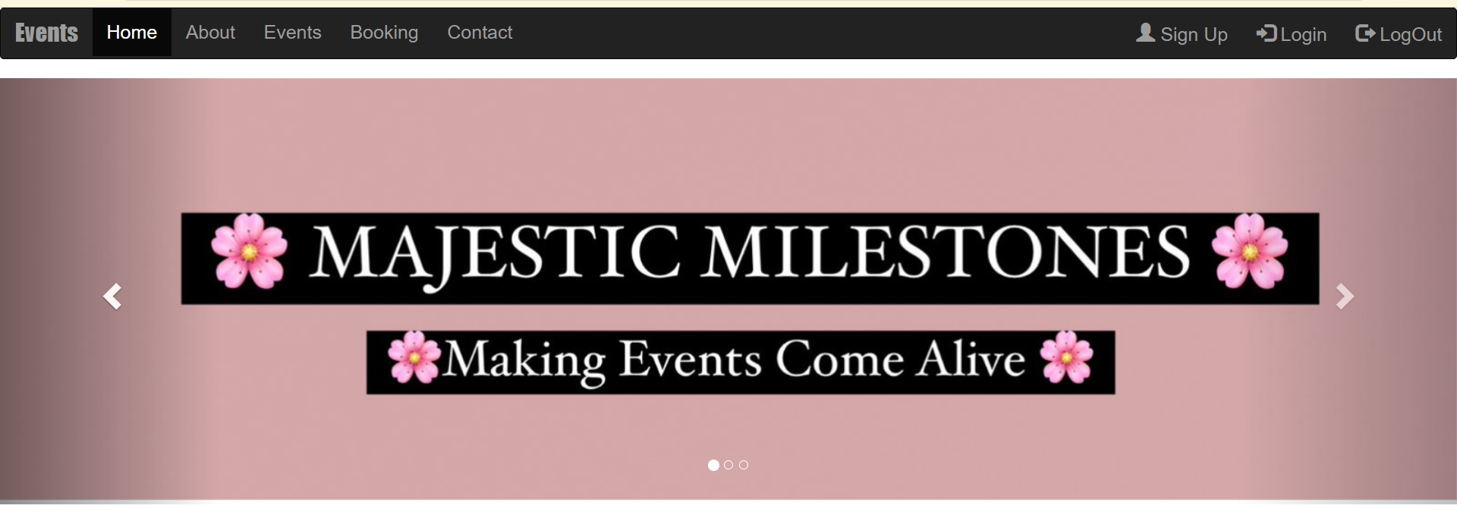
Outputs
Home Page:

Slide 5
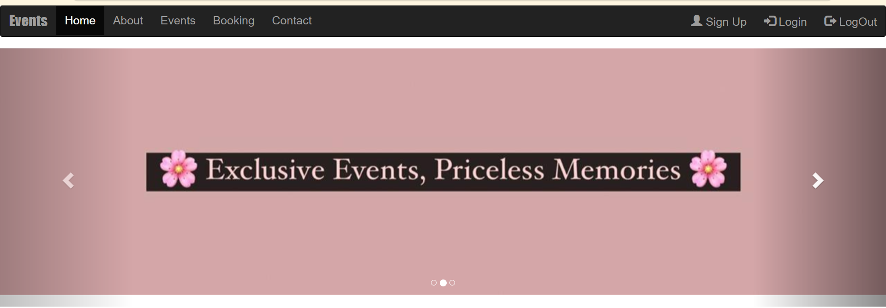
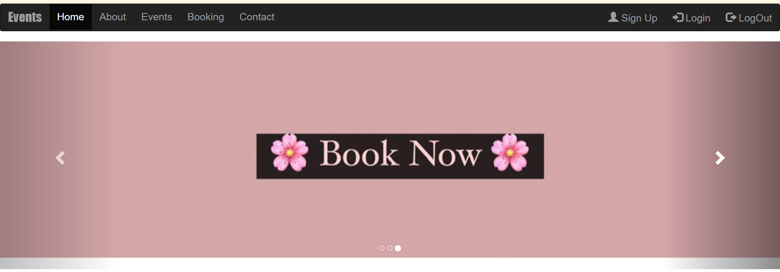

Slide 6
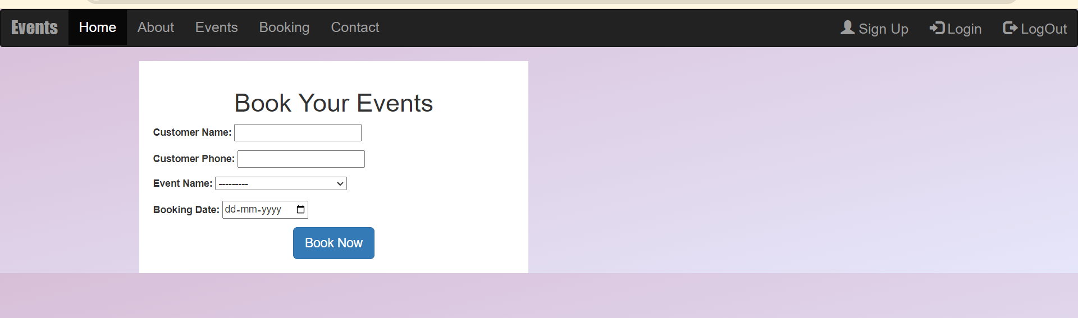
Booking Page

Slide 7
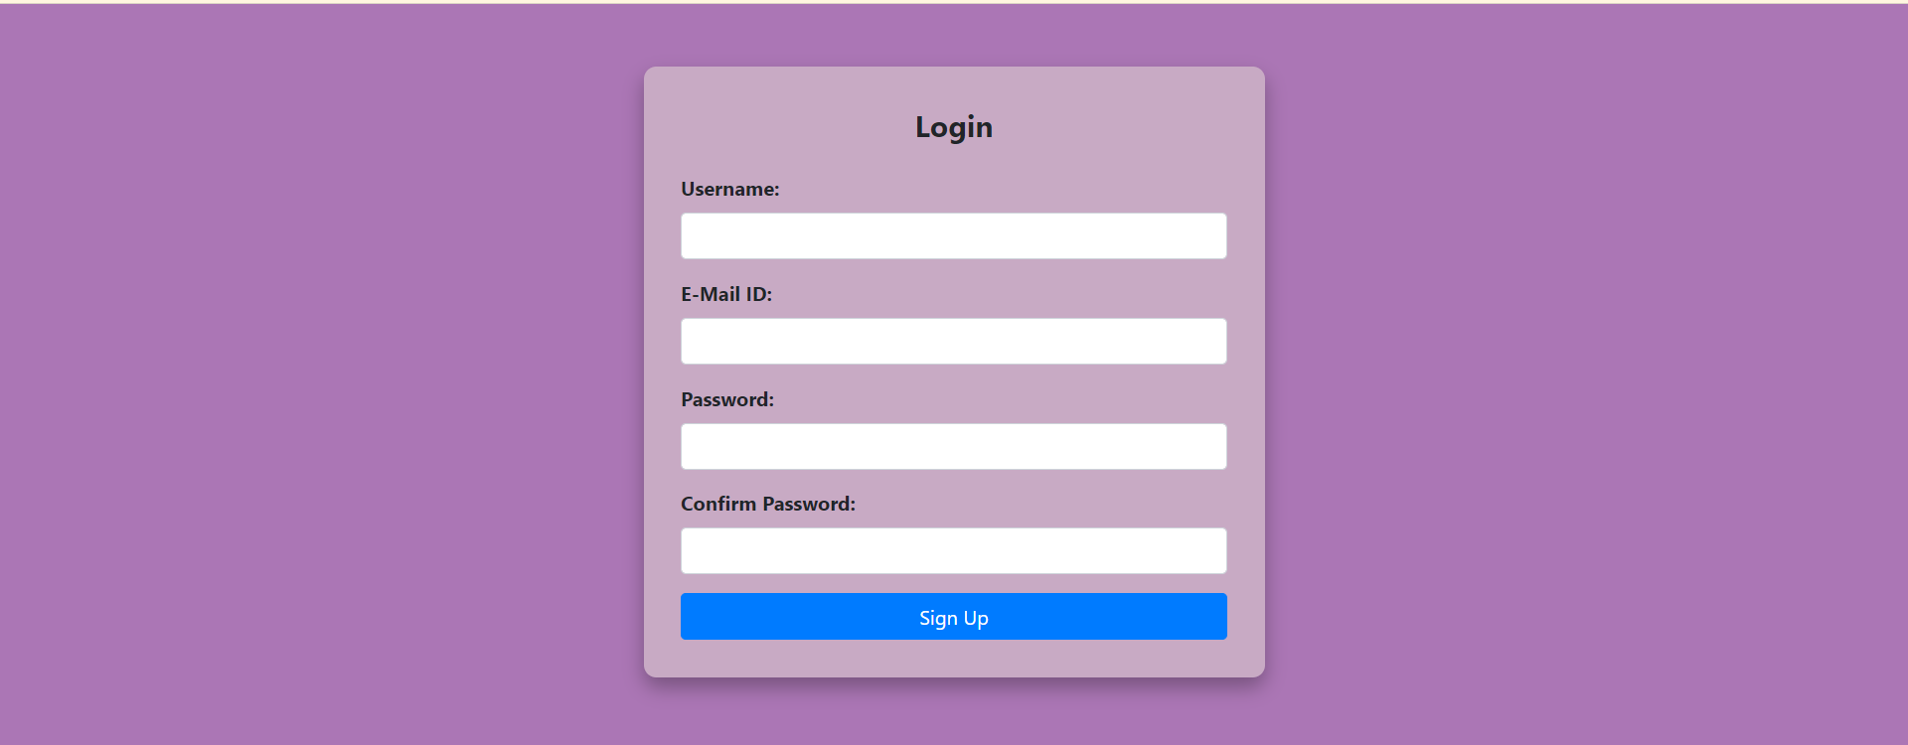
Sign-in Page

Slide 8

Login Page

Slide 9
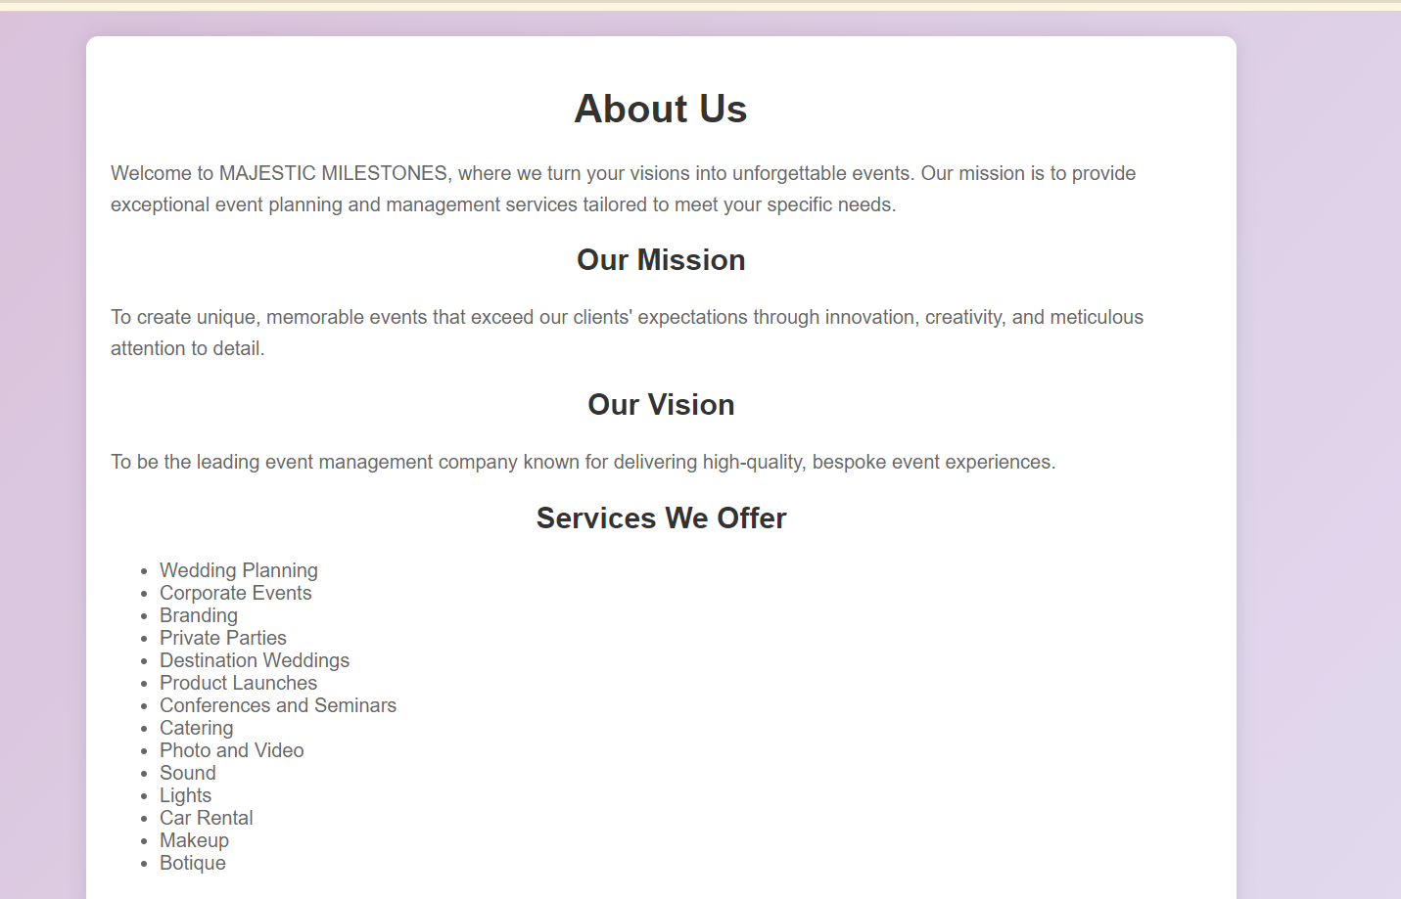
About Us Page

Slide 10
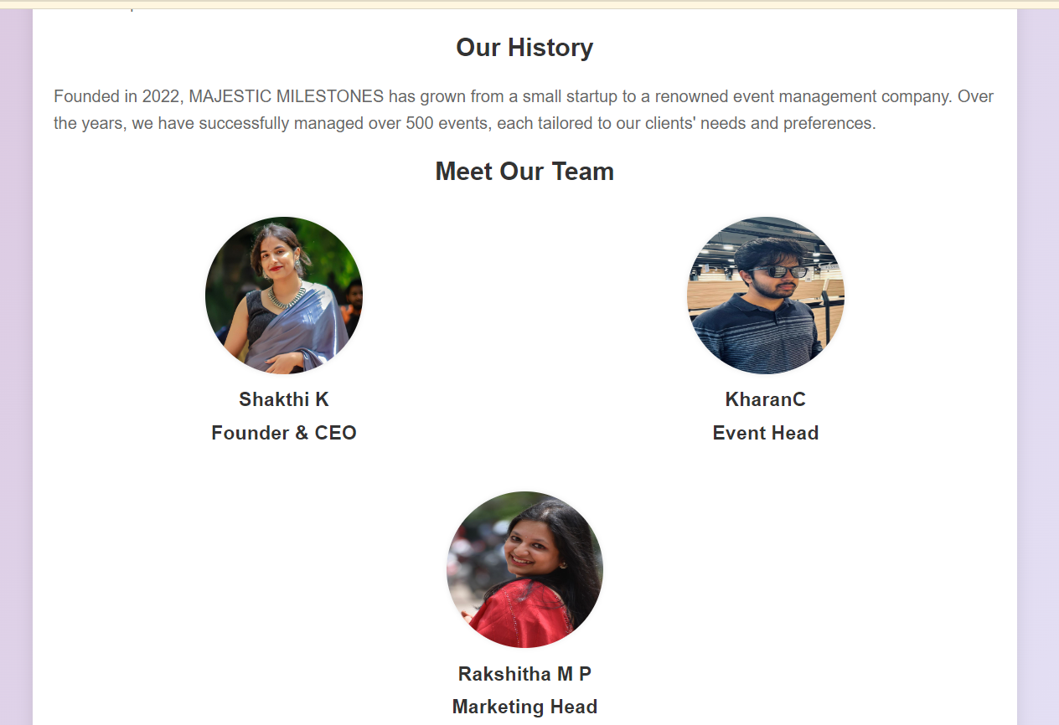
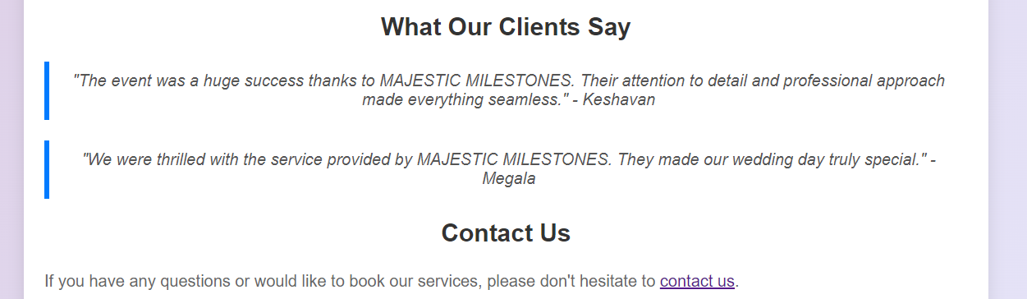

Slide 11
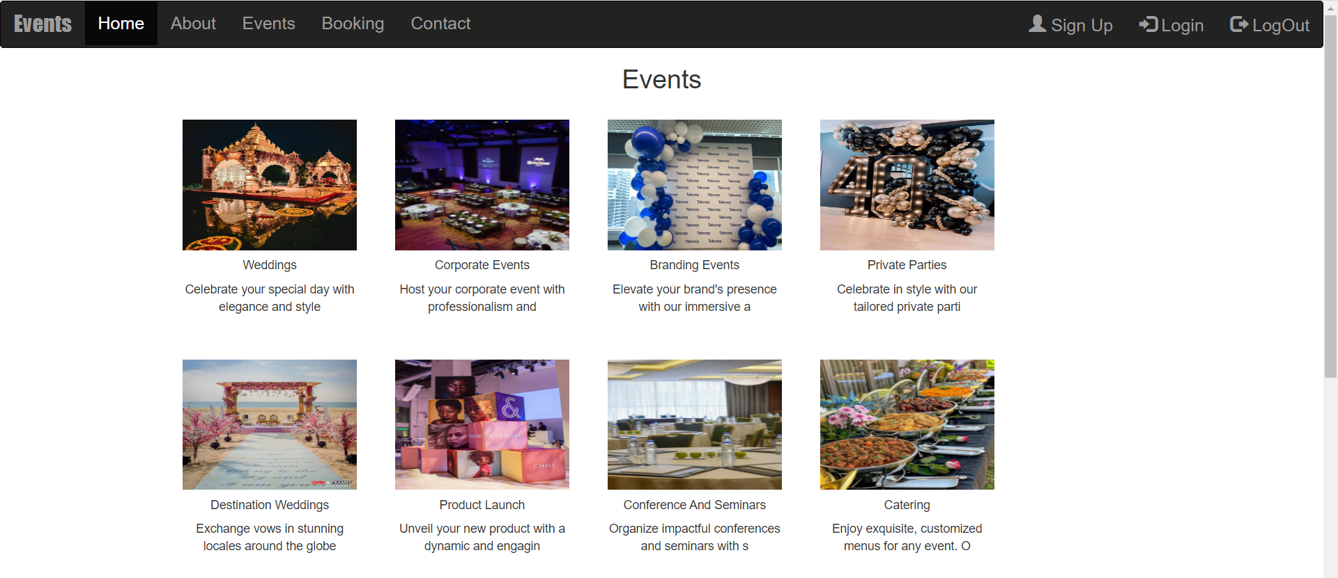
Events Page

Slide 12
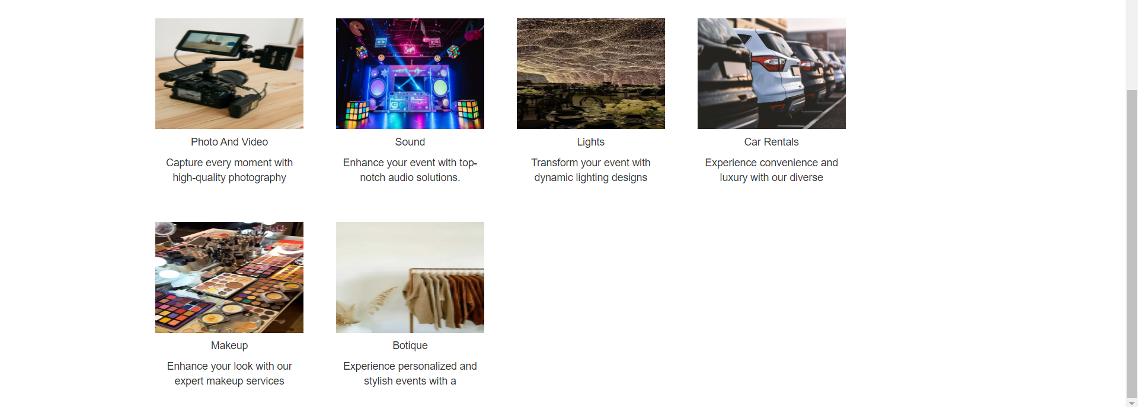

Slide 13
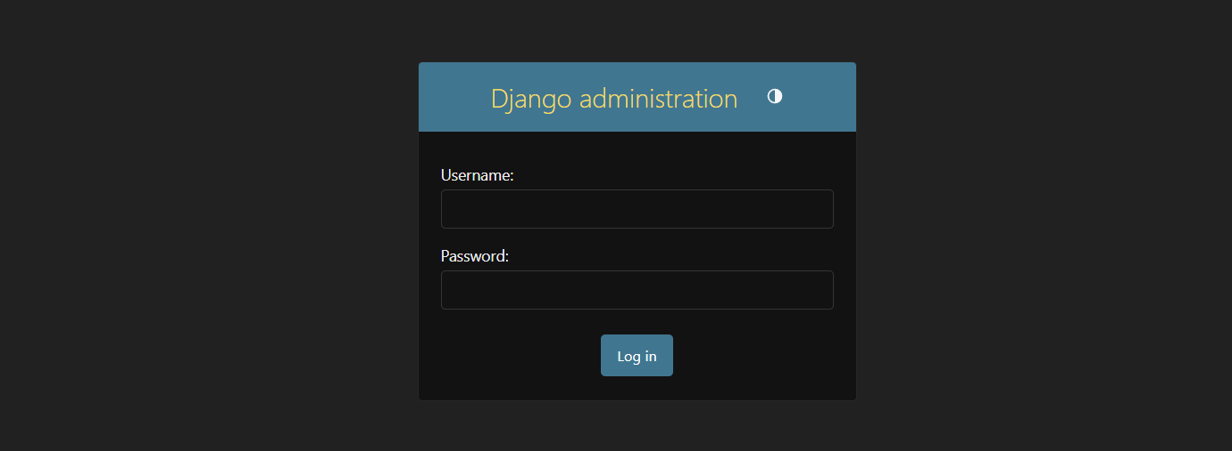
Admin Login Page

Slide 14
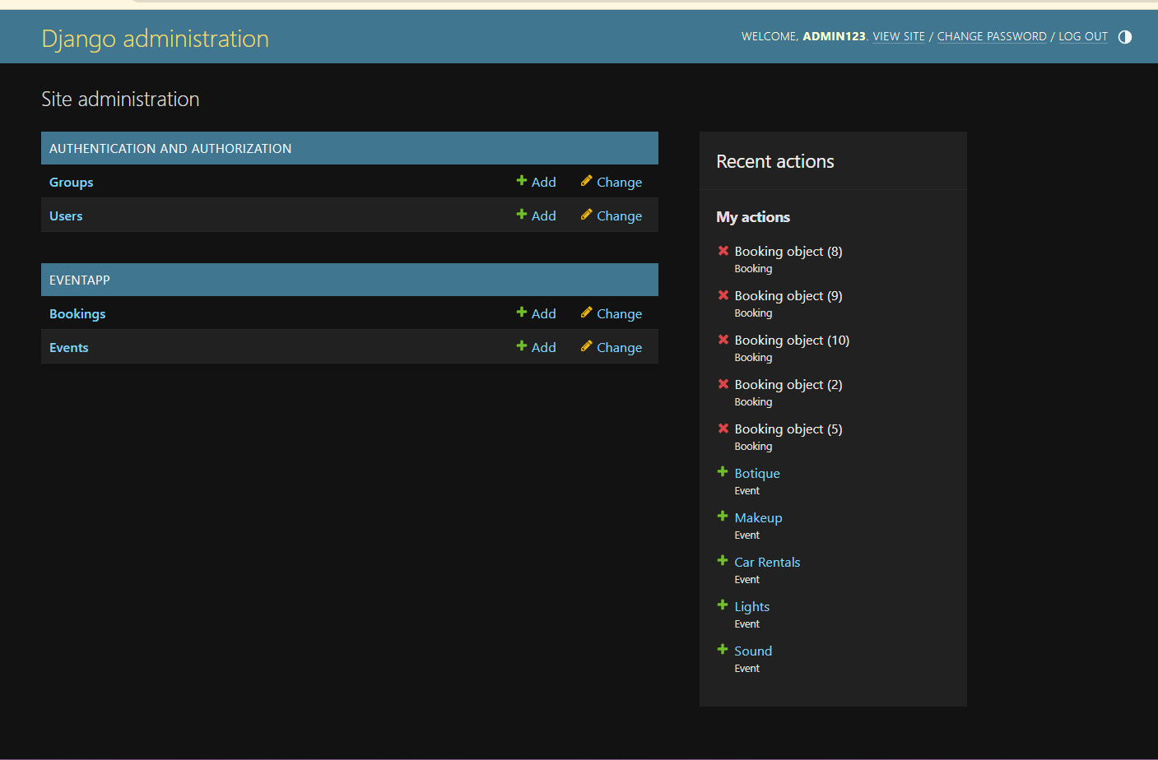
Admin Home Page

Slide 15
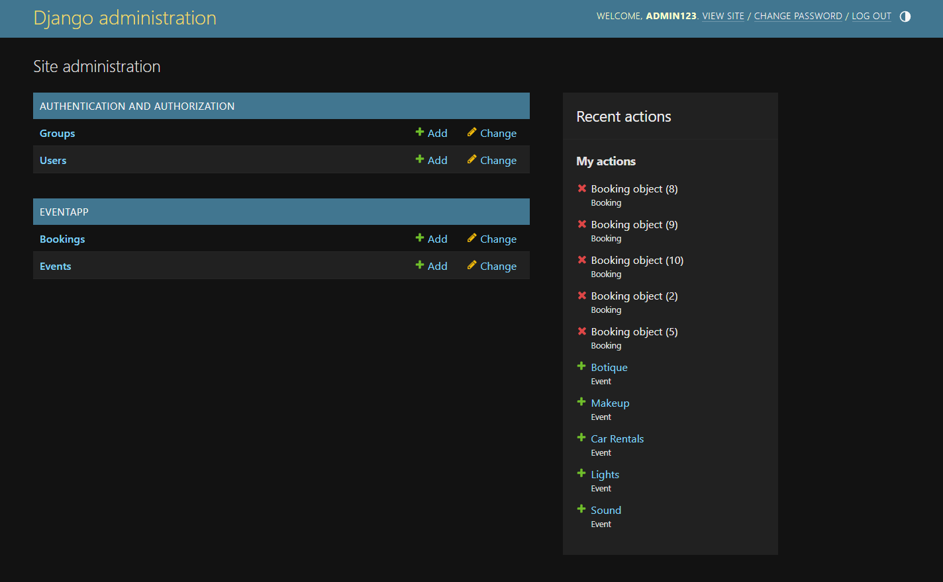
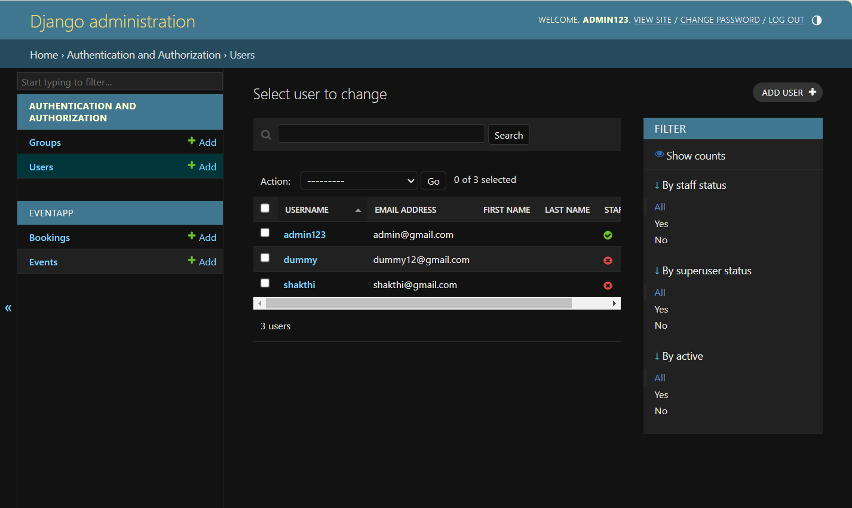

Slide 16
Events

Slide 17
Conclusion
This project demonstrates the effective use of Django in developing a functional and visually appealing event management system. By adhering to best practices in web development and focusing on both functionality and user experience, the platform sets a solid foundation for future growth and enhancement. The combination of a well-thought-out design and robust backend ensures that the website can effectively meet the needs of users, making event planning and management a seamless experience.

Slide 18
THANK YOU

